Slide 1
MONITOR PS

Slide 2
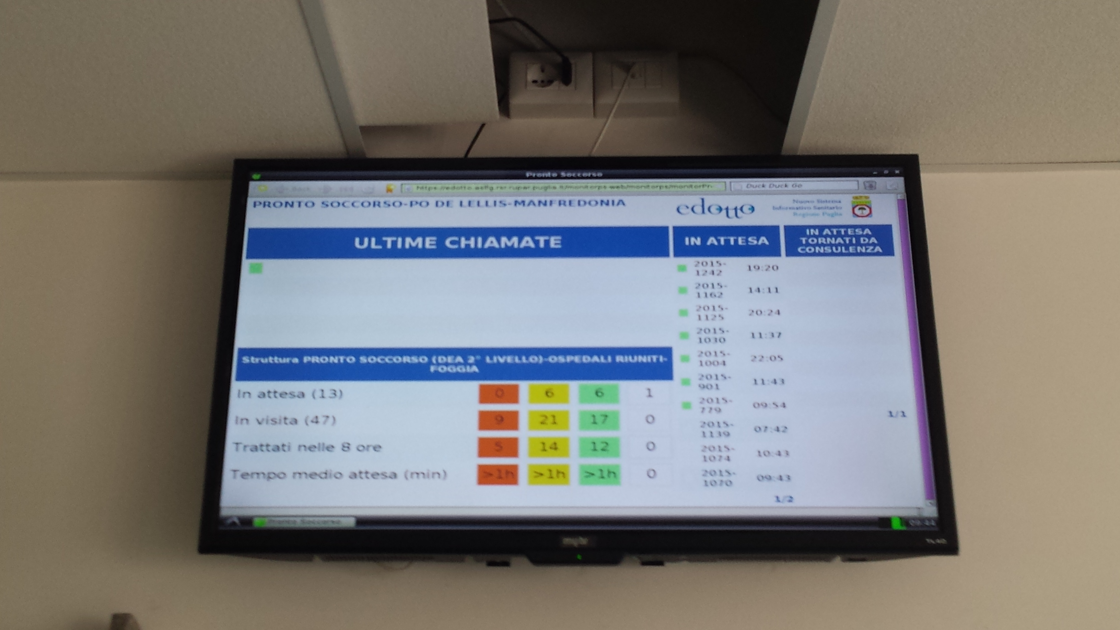

Slide 5
PS Manfredonia

Slide 7
Raspberry mod. B+ costo 35€

